Slide 1


SPRING VALLEY VILLAGE POLICE DEPARTMENT
MONTHLY NEWSLETTER:
FEBRUARY 2026
1025 CAMPBELL ROAD
HOUSTON, TX 77055
PHONE: 713-465-8323
COMMUNITY MATTERS.
WE ARE A TEAM.

Slide 2

INTRODUCTION
Spring Valley Village Residents,
We hope the new year is off to a good start. See the information for the Home Safe and Safe check programs we offer. Below are a few more things to keep in mind while you go about your daily activities. As always, we are available whenever you have concerns.
KEEP IN MIND:
  Be sure to lock all doors and windows in your home, when you are not on the premises.
  Lock your vehicle when it is unoccupied.
  Be cautious while in and around our school zones
Sincerely,
Chief M. Schulze
1025 CAMPBELL ROAD, HOUSTON, TX 77055
PHONE: 713-465-8323 / EMAIL: DISPATCH@SPRINGVALLEYTX.COM

Slide 3


FEBRUARY 2026
DATE | DAY | SPECIAL DAYS FOR THIS MONTH
02-14-2026 | SATURDAY | VALENTINE’S DAY
02-16-2026 | MONDAY | PRESIDENT’S DAY
COMMUNITY MATTERS.
WE ARE A TEAM.
1025 CAMPBELL ROAD, HOUSTON, TX 77055 / PHONE: 713-465-8323 / EMAIL: DISPATCH@SPRINGVALLEYTX.COM

Slide 4


SAFE CHECK
In the event of an emergency, ensuring the safety and well-being of all our residents is our top priority. We invite you to fill out our Spring Valley Safe Check form. By registering, you can alert our police department and first responders about any unique requirements for you or your loved ones in case of a disaster. This includes information about the number of people and pets in your household, any special medical equipment that needs to be transported, and other critical details that will help us provide the best possible care and support during an evacuation.
HOME SAFE
the SVV Home Safe program is for anyone who may not be able to speak to emergency personnel for various physical/mental challenges (i.e., Autism, Alzheimer’s, Down Syndrome, etc.) that live in the City of Spring Valley Village.
If the person is registered with the program and is found wandering or reported missing, officers can look for their information in a computer database. Using the person’s physical description and photograph, officers can determine who they are, where they live and contact a caregiver.
Both registration forms can be found on City of Spring Valley Village website, www.springvalleytx.com under the Departments drop down menu and Police Department.
COMMUNITY MATTERS.
WE ARE A TEAM.
1025 CAMPBELL ROAD, HOUSTON, TX 77055
PHONE: 713-465-8323 / EMAIL: DISPATCH@SPRINGVALLEYTX.COM

Slide 5

SPRING VALLEY POLICE DEPARTMENT
The Spring Valley Village Police Department would like to remind the public of a recent change in Texas law that eliminated temporary paper license plates. As a result, vehicles are now issued permanent metal license plates at the time of purchase.
We encourage residents to take steps to help protect their license plates from theft or tampering.
Tips to Secure Your License Plates:
Use tamper-resistant or anti-theft screws (these can be found on Amazon)
Install a locking license plate frame (can be found on Amazon)
Park in well-lit areas or inside a garage when possible
Use security cameras or motion-activated lighting
Periodically check plates to ensure they are secure
If your license plate is lost or stolen, please report it promptly to the Spring Valley Police Department at 713-465-8323.
Thank you for your continued cooperation in keeping our community safe.
Captain C. Menchaca
COMMUNITY MATTERS.
WE ARE A TEAM.
1025 CAMPBELL ROAD, HOUSTON, TX 77055
PHONE: 713-465-8323 / EMAIL: DISPATCH@SPRINGVALLEYTX.COM

Slide 6
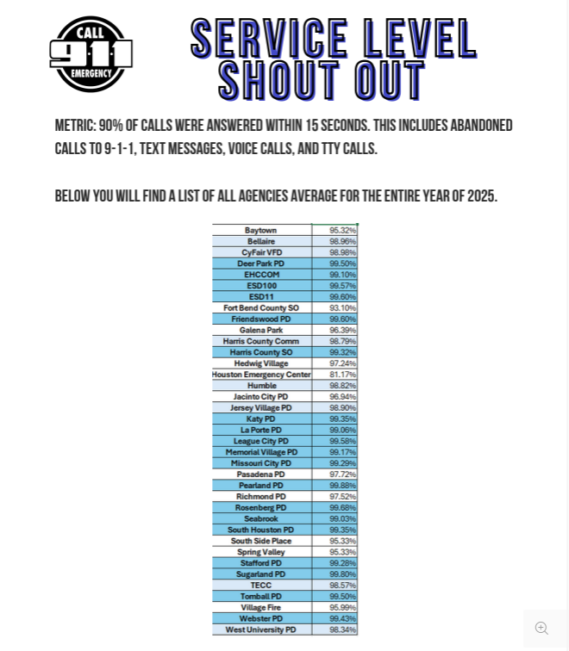

FSPRING VALLEY POLICE DEPARTMENT
COMMUNITY MATTERS.
WE ARE A TEAM.
1025 CAMPBELL ROAD, HOUSTON, TX 77055
PHONE: 713-465-8323 / EMAIL: DISPATCH@SPRINGVALLEYTX.COM

Slide 7
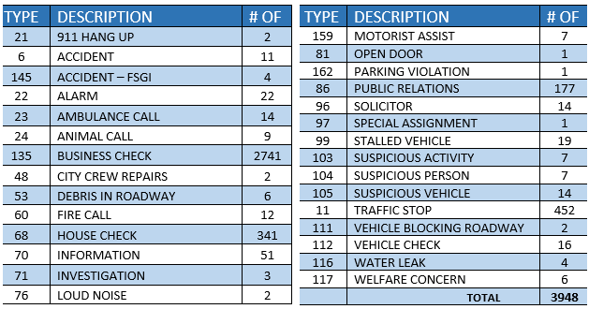
SPRING VALLEY POLICE DEPARTMENT
SPRING VALLEY VILLAGE
CALLS BY TYPE: 01-01-2026 THRU 01-31-2026
COMMUNITY MATTERS.
WE ARE A TEAM.
1025 CAMPBELL ROAD, HOUSTON, TX 77055
PHONE: 713-465-8323 / EMAIL: DISPATCH@SPRINGVALLEYTX.COM

Slide 8
IMPORTANT NUMBERS AT A GLANCE
EMERGENCY |  | NON - EMERGENCY
911 - FOR ALL EMERGENCY |  | 713-465-8323
988 – NATIONAL SUICIDE & MENTAL HEALTH
SPRING VALLEY VILLAGE |  | VILLAGE FIRE DEPARTMENT
SPRING VALLEY - CITY HALL | 713-465-8308 | VILLAGE FIRE DEPARTMENT |  | 713-465-2323
SPRING VALLEY - PD | 713-465-8323 | VFD - NON-EMERGENCY |  | 713-468-7941
SPRING VALLEY - PD FAX | 713-465-3135
SPRING VALLEY - COURT | 713-465-0333
HILSHIRE VILLAGE
HILSHIRE VILLAGE – CITY HALL | 713-973-1779
COMMUNITY MATTERS.
WE ARE A TEAM.
1025 CAMPBELL ROAD, HOUSTON, TX 77055 / PHONE: 713-465-8323 / EMAIL: DISPATCH@SPRINGVALLEYTX.COM

